Slide 1
Advanced Persistent Threat 1
By: Travis Brinson & Pawan Chandra

Slide 2

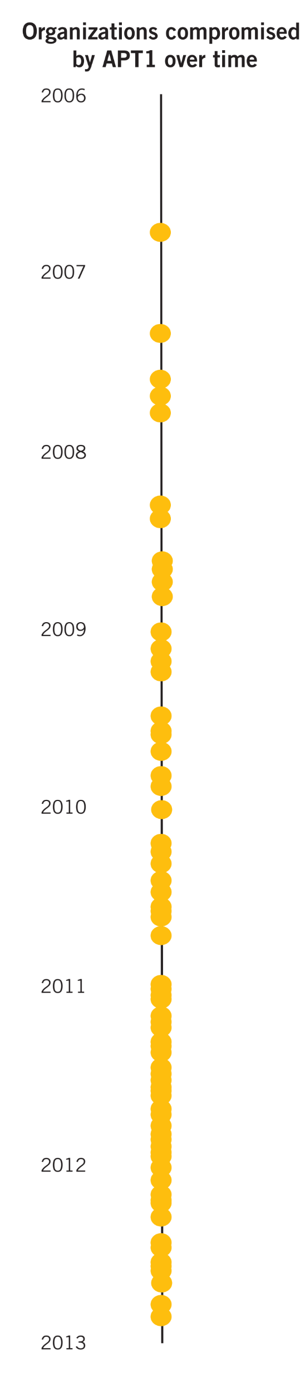
APT1 – Years of Espionage
APT1 has been stealing hundreds of terabytes of data from at least 141 organizations across a diverse set of industries beginning as early as 2006

Slide 3
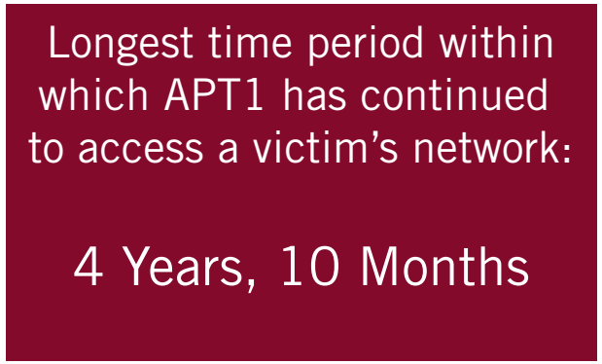
Duration
Once APT1 has compromised a network, they repeatedly monitor and steal proprietary data and communications from the victim for months or even years

Slide 4
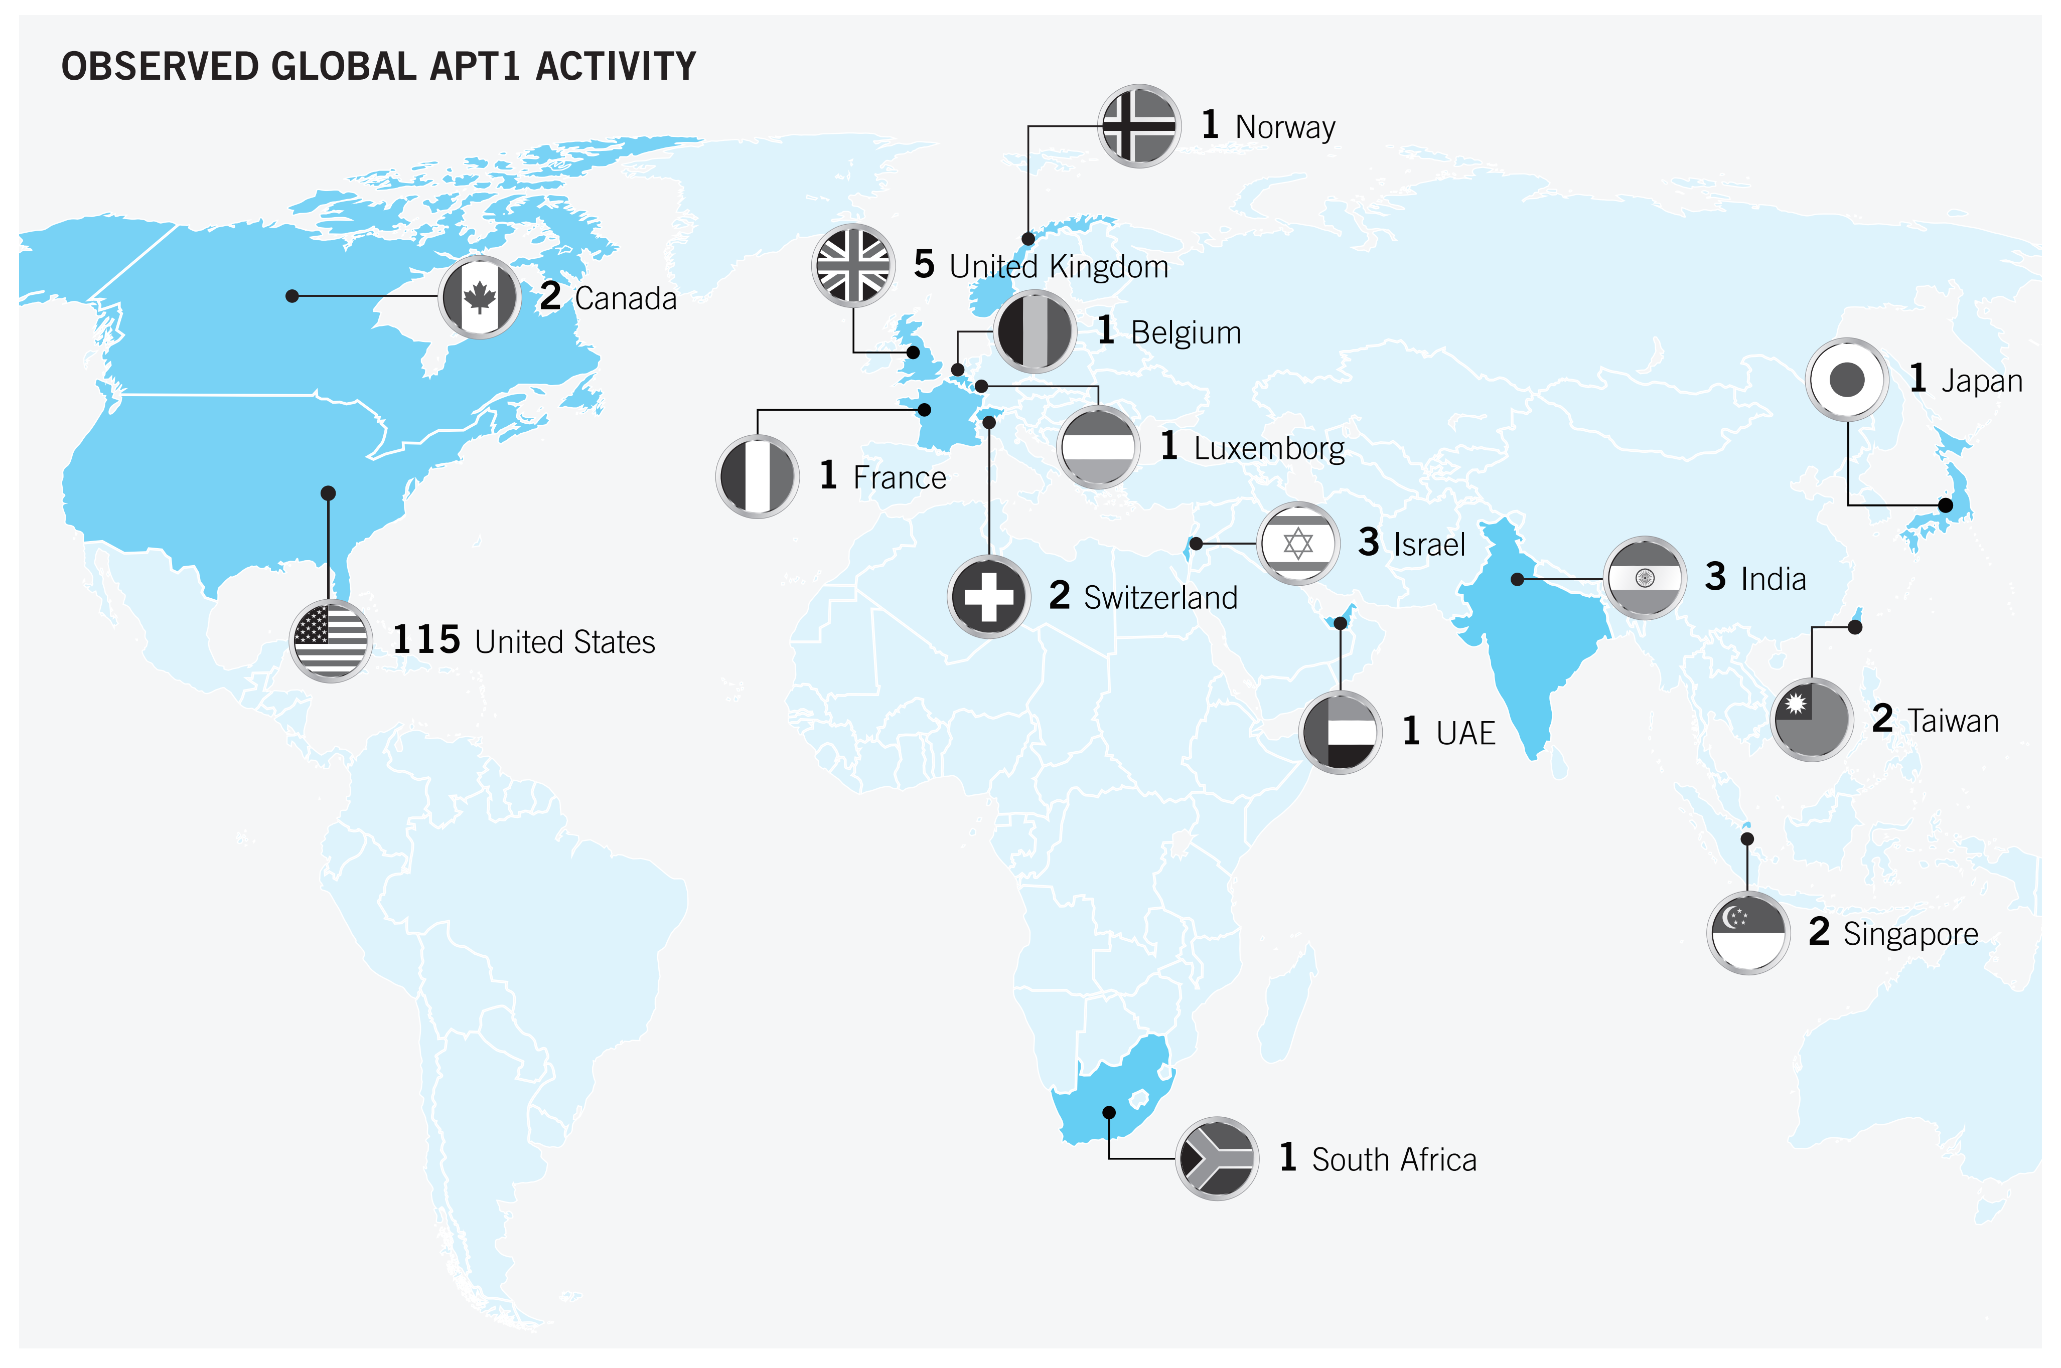
Geography
About 87% of the victims are located in countries where English is the native language.
115 victims located in the U.S. and
7 in Canada and the United Kingdom
These other locations reflect either the branch of the organization that APT1 compromised or the location of the organization’s headquarters.

Slide 5

Industry
APT1 has show un there intent and proven that they are more then capable to steal from dozens of organizations across a wide range of industries virtually simultaneously.
The group does not target industries systematically but more likely steals from an enormous range of industries on a continuous basis.

Slide 6
Timeline
The dots within each bar represent the earliest known date on which APT1 compromised a new organization within the industry

Slide 7
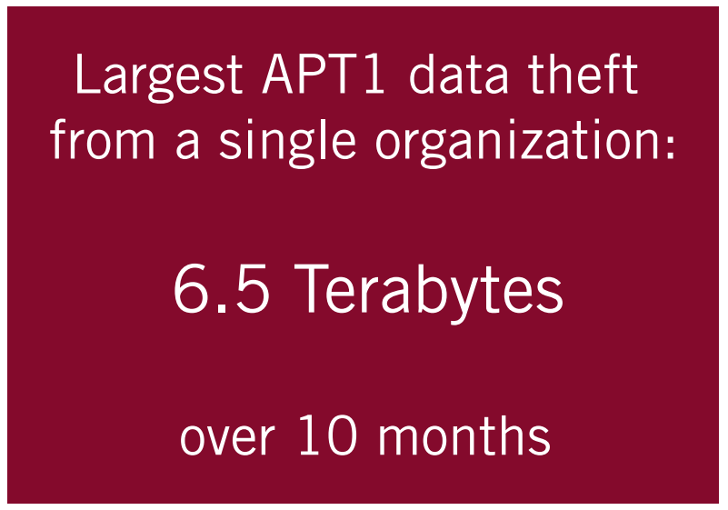
Data Theft
Product development and use
Manufacturing procedures
Business plans
Policy positions and analysis
Emails
User credentials and network architecture

Slide 8
News and Predicaments
Public reporting helps us get a better understanding of APT1’s cyber activity. However, several factors complicate the process of compiling and synthesizing public reports on APT1
1
1) Researchers and journalists refer to APT1 by variety of nicknames causing confusion.
2
2) Cyber security analysts focus on writing about tools that are shared between multiple Chinese APT groups without differentiating between the various actors that use them
3

Slide 9
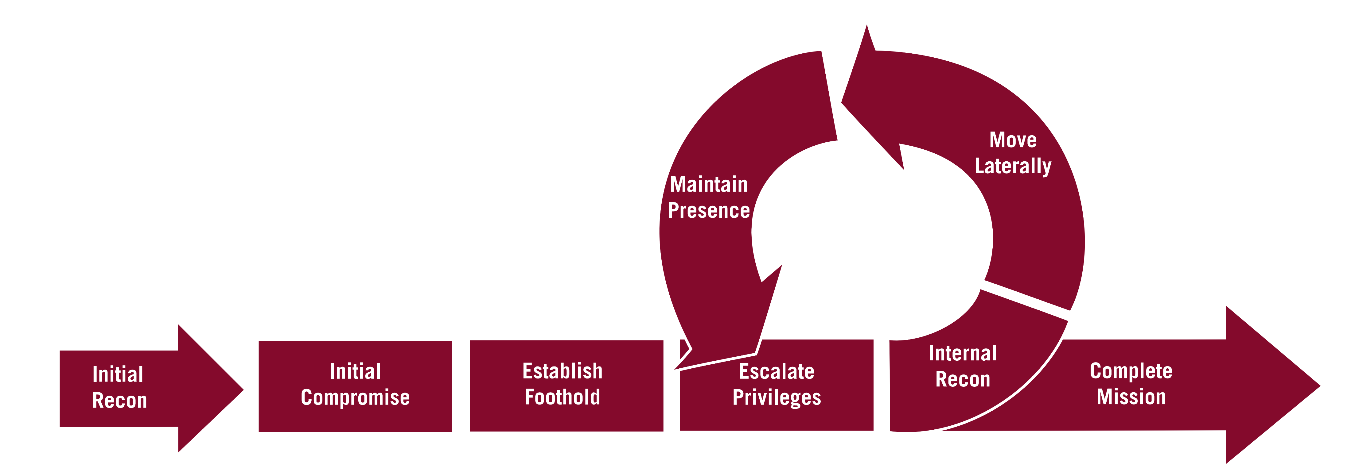
APT1 – Attack Lifecycle
APT1 has a well-defined attack methodology, designed to steal massive quantities of intellectual property. They begin with aggressive spear phishing, proceed to deploy custom digital weapons, and end by exporting compressed bundles of files to China – before beginning the cycle again.

Slide 10
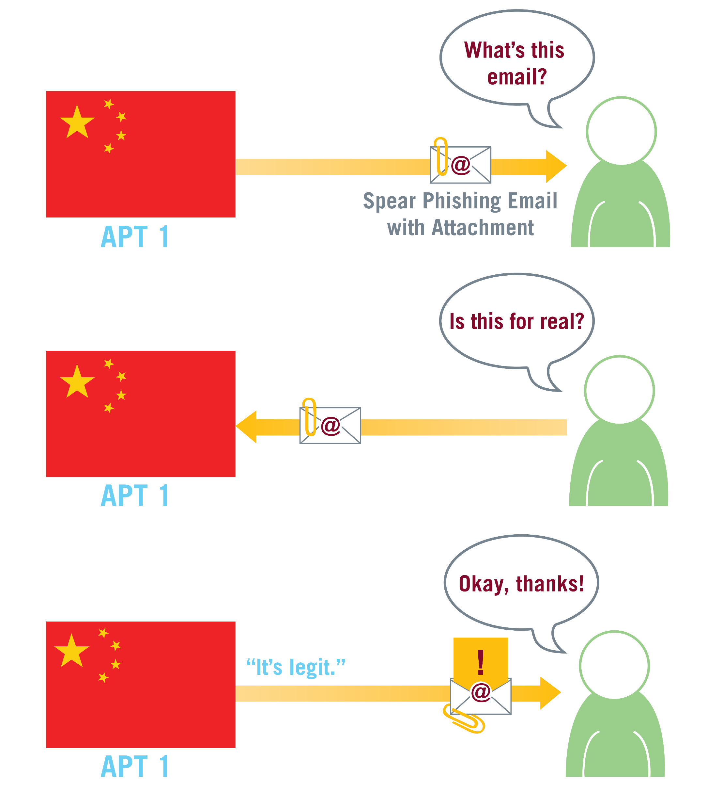
Initial Compromise
The very first step in the APT1’s attack methodology is to penetrate a target organization’s network. Most common way is through spear phishing emails

Slide 11
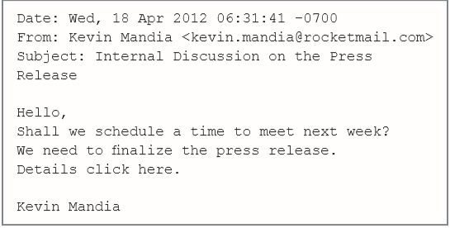
Spear Phishing Emails
Spear phishing emails contain either a malicious attachment or a hyperlink to a malicious file.
The subject line and the text in the email body are usually relevant to the recipient. APT1 also creates webmail accounts using real peoples’ names — names that are familiar to the recipient, such as a colleague, a company executive, an IT department employee etc.— and uses these accounts to send the emails.

Slide 12

Establish Foothold
Once the APT1 has successfully infiltrated a network, they must then control the target network systems from outside.
A backdoor is software that allows an intruder to send commands to the system remotely
Beachhead vs Standard

Slide 13
Beachhead Backdoor
Minimally featured
Gives the attacker enough access to perform simple tasks like
retrieve files
gather basic system information.
Trigger the execution of other more significant capabilities such as standard backdoor
WEBC2 backdoors.
Retrieves a webpage from a C2 server.
Give APT1 attackers a short and rudimentary set of commands to issue to victim systems, including:
Open an interactive command shell (usually Windows’ cmd.exe)
Download and execute a file
Sleep for a specified amount of time

Slide 14
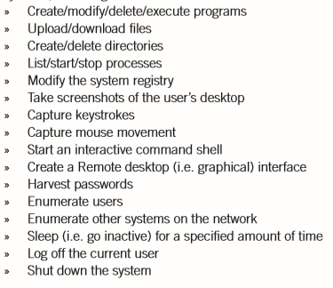
Standard Backdoors
Non-WEBC2 APT1
Communicates using the HTTP protocol (to blend in with legitimate web traffic

Slide 15
Privilege Escalation
Escalating privileges is when the attacker attempts to obtain data, such as username and password, that will allow access to more resources within the network.
APT1 predominantly uses publicly available tools to dump password hashes from victim systems in order to obtain legitimate user credentials.

Slide 16
Internal Recon
In the Internal Reconnaissance stage, the intruder collects information about the victim environment
APT1 primarily uses built-in operating system commands to explore a compromised system and its networked environment. Sometimes intruders may use batch scripts to speed up the process

Slide 17
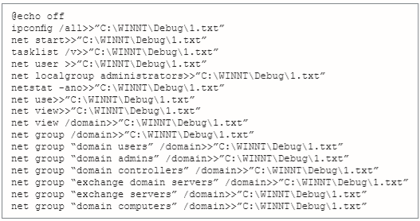
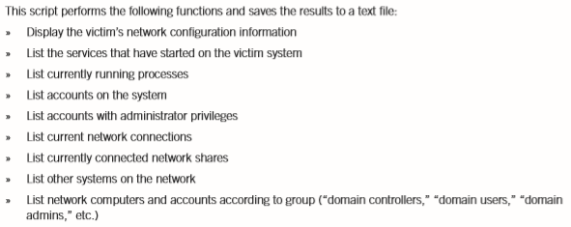
Internal Recon

Slide 18
Move Laterally
Once an APT intruder has a foothold inside the network and a set of legitimate credentials, it is simple for the intruder to move around the network undetected:
They can connect to shared resources on other systems
They can execute commands on other systems using the publicly available “psexec” tool from Microsoft System internals or the built-in Windows Task Scheduler (“at.exe”)

Slide 19
Maintain Presence
In this stage, the intruder takes actions to ensure continued, long-term control over key systems in the network environment from outside of the network. APT1 does this in three ways
Install new backdoors on multiple systems
Use legitimate VPN credentials
Log in to web portals

Slide 20
Maintain Presence: New Backdoors
Throughout their stay in the network, APT1 usually installs new backdoors as they claim more systems in the environment. Then, if one backdoor is discovered and deleted, they still have other backdoors they can use.
We usually detect multiple families of APT1 backdoors scattered around a victim network when APT1 has been present for more than a few weeks

Slide 21
Maintain Presence: Legitimate VPN
APT actors and hackers in general are always looking for valid credentials in order to impersonate a legitimate user.
APT1 use stolen usernames and passwords to log into victim networks’ VPNs when the VPNs are only protected by single-factor authentication. From there they are able to access whatever the impersonated users are allowed to access within the network.

Slide 22
Maintain Presence: Web Portals
Once armed with stolen credentials, APT1 intruders also attempt to log into web portals that the network offers. This includes not only restricted websites, but also web-based email systems such as Outlook Web Access.

Slide 23

Complete Mission
Once APT1 finds files of interest they pack them into archive files before stealing them
APT intruders most commonly use the RAR archiving utility for this task and ensure that the archives are password protected. Sometimes APT1 intruders use batch scripts to assist them in the proce

Slide 24
Advanced Persistent Threat 1 Infrastructure
APT1 Maintains an extensive infrastructure across the world originating in China, this section will dig deeper into this.

Slide 25

Network Origins
Why we can’t just block all suspicious Chinese addresses?
“Hop Points” allow APT1 to appear to be attacking from almost any country
These “Hop Points” appear to be accessed by sites owned by China Unicom, Shanghai Network
This suggests that APT1 is Chinese based
Additionally:
These blocks serve the Pudong New Area of China where another threat Until 61389 is based
Left over RDP data shows the chosen keyboard layout of the accessors are “Chinese (Simplified) — US Keyboard”

Slide 26
Interaction with backdoors
APT1 uses hops to connect to and control infected systems
The victim systems often regularly connect to these hops waiting for commands and to drop payloads of files
This behavior is tool specific

Slide 27
Manual WEBC2 updates
WEBC2 backdoor variants download and interpret command hidden between HTML tags
These pages are usually hosted on APT1’s hop network
It was observed that APT1 members log on to these servers to update commands, either by pasting the preformed commands or uploading the entire file.

Slide 28
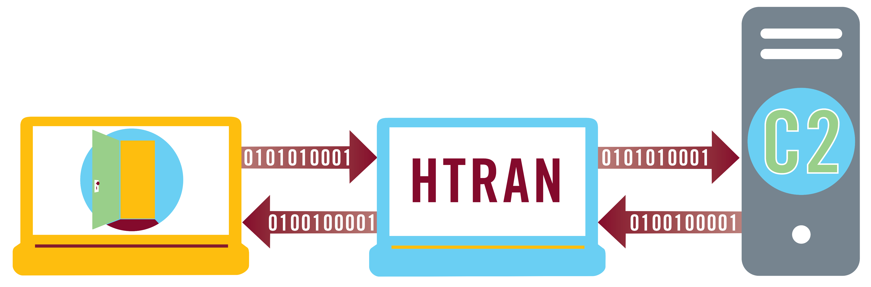
HTRAN
HTRAN is a packet forwarding server
APT1 uses HTRAN to forward Command and Control (C2) Packets through their “Hop” servers
This allows APT1 members to control remote systems without it coming directly from their own IP

Slide 29
C2 Server Software on hop infrastructure
Instead of using HTRAN some APT1 members will install a C2 server on their hops and remotely connect to that to issue commands
Hops being used in this way may also include software to more easily interface with their backdoor software
Receiving connections from the backdoor software
Translating commands into the proper HTML format

Slide 30
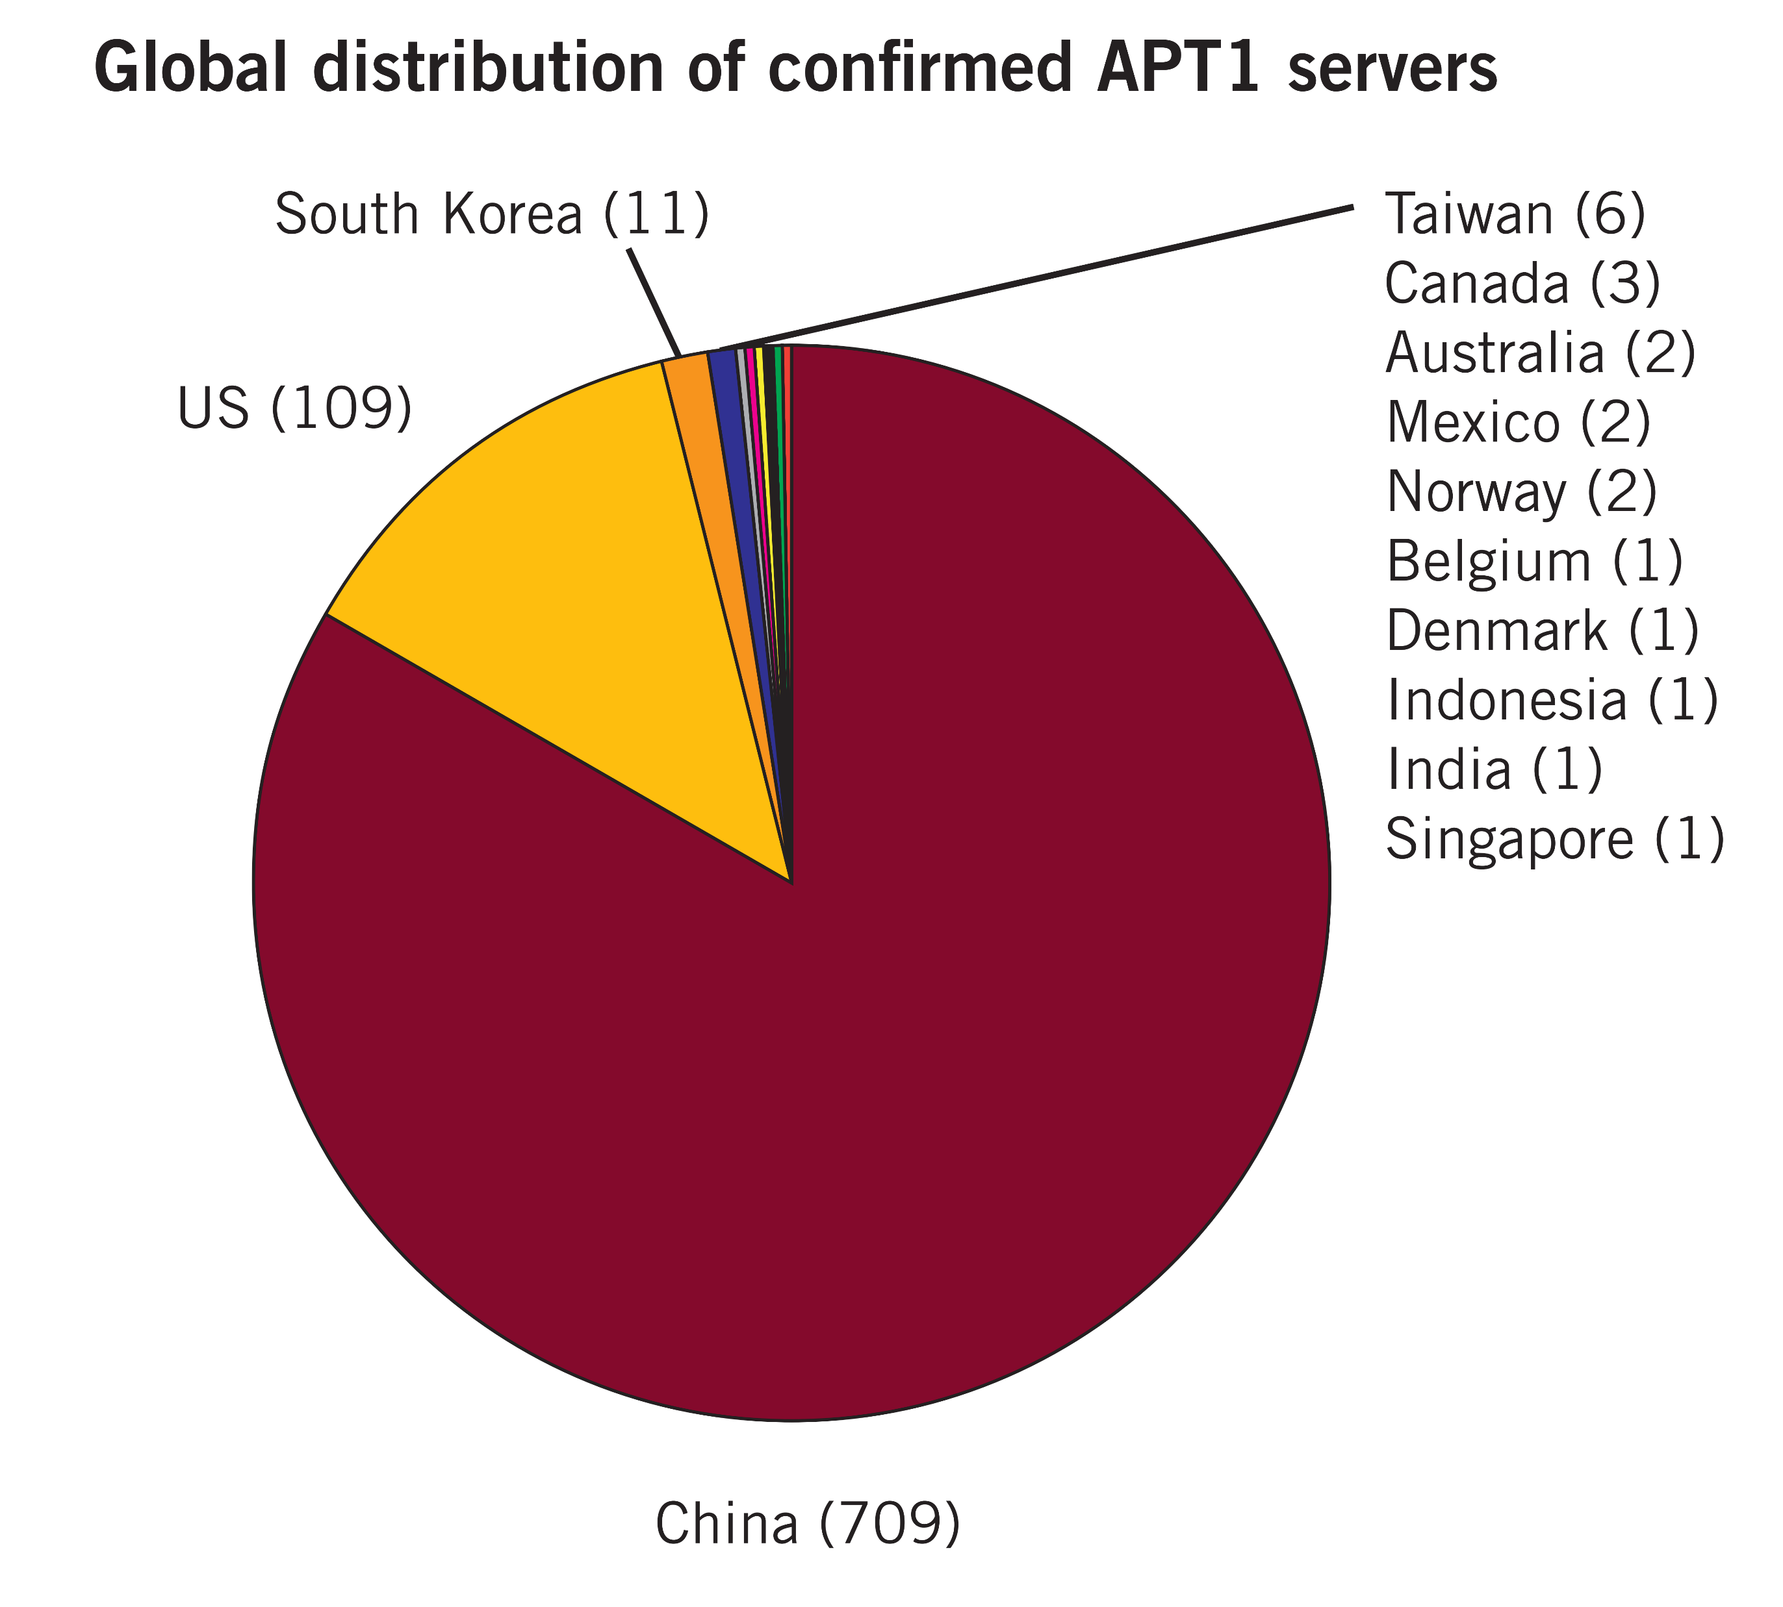
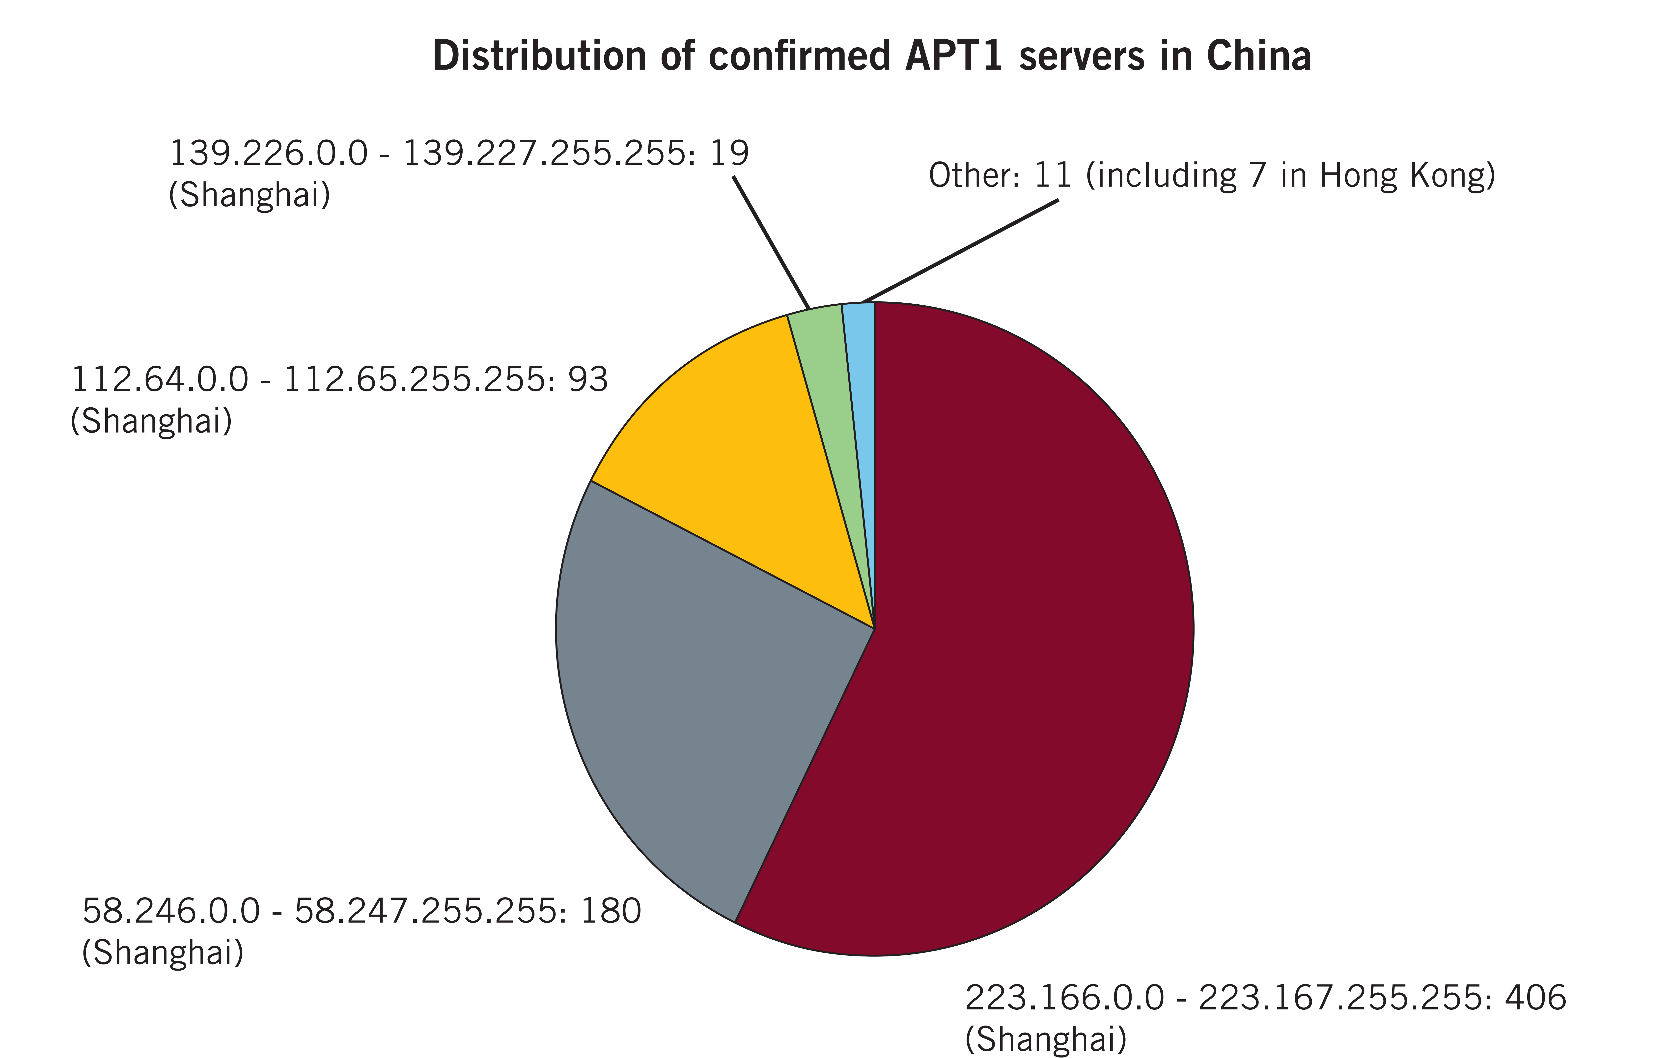
Servers
Confirmed 937 APT1 C2 Servers running on 849 distinct IP Addresses

Slide 31
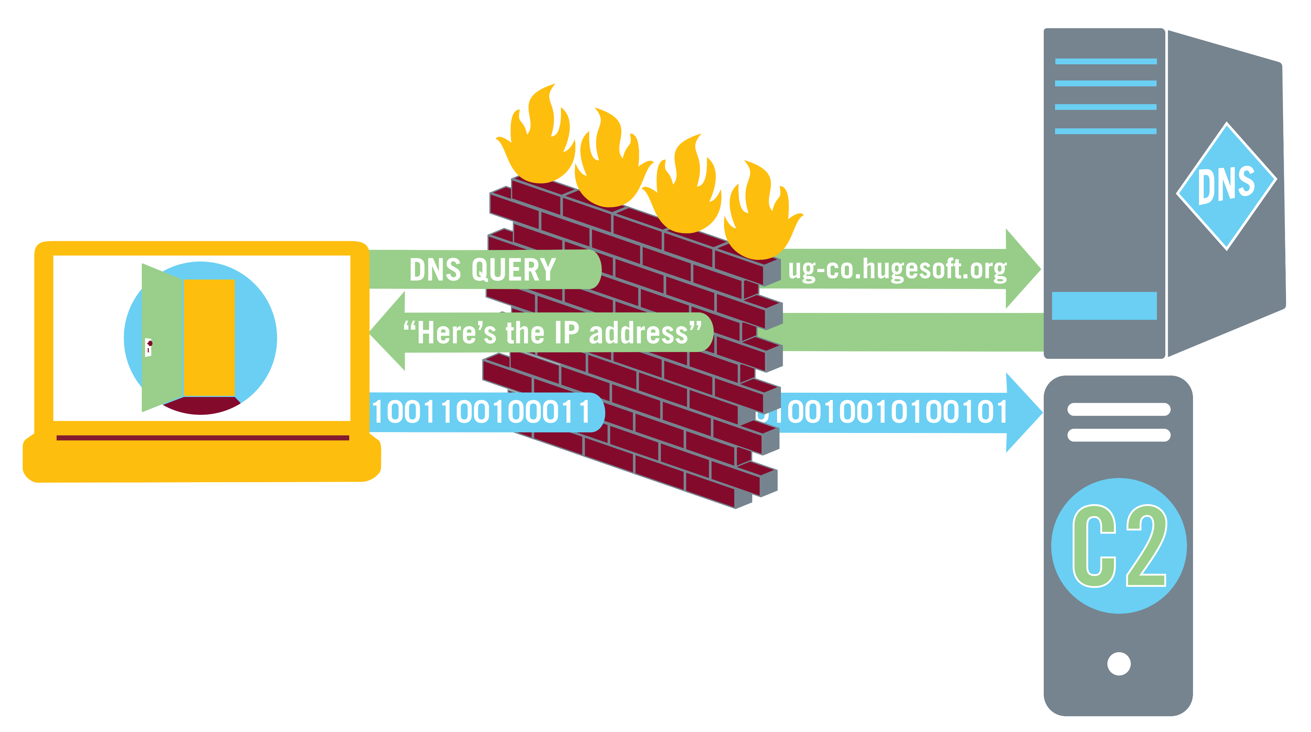
Domain Name
APT1 uses Fully Qualified Domain Names as part of their infrastructure
These addresses point to their C2 servers and are embedded into their backdoors
Since these addresses point to the actual IP they can be changed as hops get compromised or offline
APT1 FQDN’s can be grouped into 3 Categories
Registered zones
Third-party zones
Hijacked domains

Slide 32
Reregistered Zones
For Context:
A DNS Zone represents a combination of FQDN’s that end in the same name
Google.com is a zone as its subservices have redirects like calendar.google.com or maps.google.com
In AP1’s case these zones and their associated addresses resolve most likely to their own hop servers
Registration information of these zones has pointed us toward china and even specific APT1 members

Slide 33
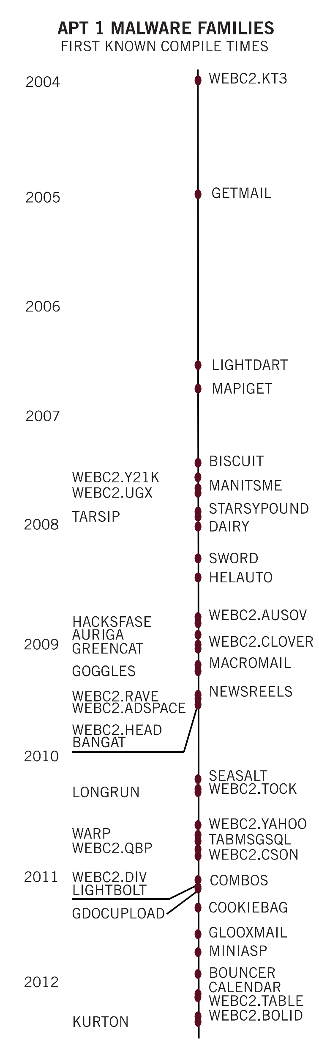
Naming Themes
APT1 Crafts their FQDN’s to appear harmless
About half fall under 3 themes
News (aoldaily.com, newsesport.com, newspapers.org, usnewssite.com, etc.)
Technology (applesoftupdate.com. dnsweb.org, softsolutionbox.net, etc.)
Business (businessconsults.net, conferencesinfo.com, etc.)
APT1 does not continue of hold all these DN’s
Some expire
Others get transfer to the organization they imitate

Slide 34
Third-Party
Of the Third-Party services that APT1 has used Dynamic DNS is the most used
Dynamic DNS allows users to register subdomains under provided zones that will resolve to the IP of their choice
To change the IP of these domains APT1 simply must update the record of the Dynamic DNS provider
Recent addresses ending in “appspot.com” indicate that APT1 may be using Google’s App Engine service

Slide 35
Hijacked FQDNs
APT1 will often use FQDN’s that are used by legitimate websites hosted on their hop points
APT1 uses these hijacked domains for two primary purposes
Using the FQDN to make placed malware appear as if it is rom a legitimate source
As C2 servers for their back

Slide 36

APT1 - Identities
APT1 has left pieces of information from the layout of their keyboards or the IP’s from their hop servers
These bits have Helped us assemble profiles of individuals and groups within the organization of APT1
Their own country’s firewall helps us as the easiest way for APT1 members to access restricted content is through their own attack infrastructure

Slide 37
APT1 - Identities
One known member Ugly Gorilla (Wang Dong) was found by piecing together information he left behind
his distinct username
tendency to certain habits
Other APT1 individuals:
DOTA – identified also by his frequent use of this username
Super Hard (Mei Qiang) – Known by communicating through these names on hacker forums and communicating with DOTA

Slide 38
Conclusion
APT1 is a threat to many businesses and institutions. They are hard to detect and crafty. APT1 has been operating at least since the early 2000 as shown in their domains and know attacks. They sneak in and over as long as they can extract an estimated Terabytes from unsuspecting companies and organizations. Their primary targets reside in the USA with very few known attacks outside the US. It is important however to note while we know of hundreds of attacks there is a distinct possibility that there exists many more that we don’t know about.

Slide 39
Conclusion
Their attacks usually consists of spear phishing emails to get a backdoor working on the victim’s computer, or a weaker backdoor with witch a more thorough one can be instated. From there they branch out across the network of the victim infecting as much of it as they can. From there they monitor their victim occasionally packaging their victim’s data up in a RAR archive and retrieving it from a proxy to their home network that is likely in Shanghai.

Slide 40
Conclusion
Security experts are advised to watch for their backdoors and to keep their systems as secure as possible. In addition informing their end user to be weary of potential spear phishing emails.
However, if you are attacked collecting as much information is possible son that APT1 can be tracked and reduced in their effectiveness.

Slide 41
Remember Be Aware and Be safe

